Slide 1

The Hewitt Foundation and the PASS Test
Ben, Genevieve Symons, Kamontat, Monty, Nirjal Shakya, Rachna Malav
CS-251

Slide 2
Table of contents
The Hewitt Foundation
Our Task
The Data
Exploration
Models
Conclusions
Citations
Test Counts
Boxplots
Bar Charts
Notes:
Nirjal
-

Slide 3
The Hewitt Foundation
“to equip families to educate their own children using the best resources available”
Based in Spokane since 1963
Resources + standardized testing (PASS Test)
2,435 Students Enrolled, 132,618 PASS Tests taken
Notes:
Rachna

Slide 4
More about the P.A.S.S test
PASS Stands for Personalized Achievement Summary System
The PASS test is like other standardized test but made especially for homeschoolers and can be administered from home.
The test assess students in three different subjects (reading, language arts and math).
Test provides 1-25 different test levels. It allow students to pick the test levels which they think would be appropriate for them.
Hewitt gives percentile of how a student did compared to other homeschoolers who took the same test, and on top of that, they’ll give a percentile of how a student did compared to a national standardized test.
Hewitt converts both the percentiles in a measure known as RIT score which would make it easier to assess each student.
Notes:
Monty

Slide 5
Our Task
Determine how much student performance has changed on the PASS test since the design in 1988 and, consequently, if the test should be re-normed
Importance: determining if it is worth the resources required to renormalize
Less modeling, more trends
Point person: Martha Gady – Board Member
Notes:
Genevieve

Slide 6
The data
Grades 3-9 (grade 9 can be disregarded)
RIT (Rasch UnIT) – measure of student’s knowledge (main Predictor for performance)
Non personalized
Previously cleaned
Challenge - large quantity, shallow
Subjects Math, Language, Reading
Math Test >30 vs <30
Notes:
Kamontat

Slide 7
Work Flow
Delegate Tasks
Individual Exploration
Discuss ideas/ Feedback
Assess next steps
Notes:
Ben

Slide 8

Graphical Observations /EDA
Notes:
Monty

Slide 9
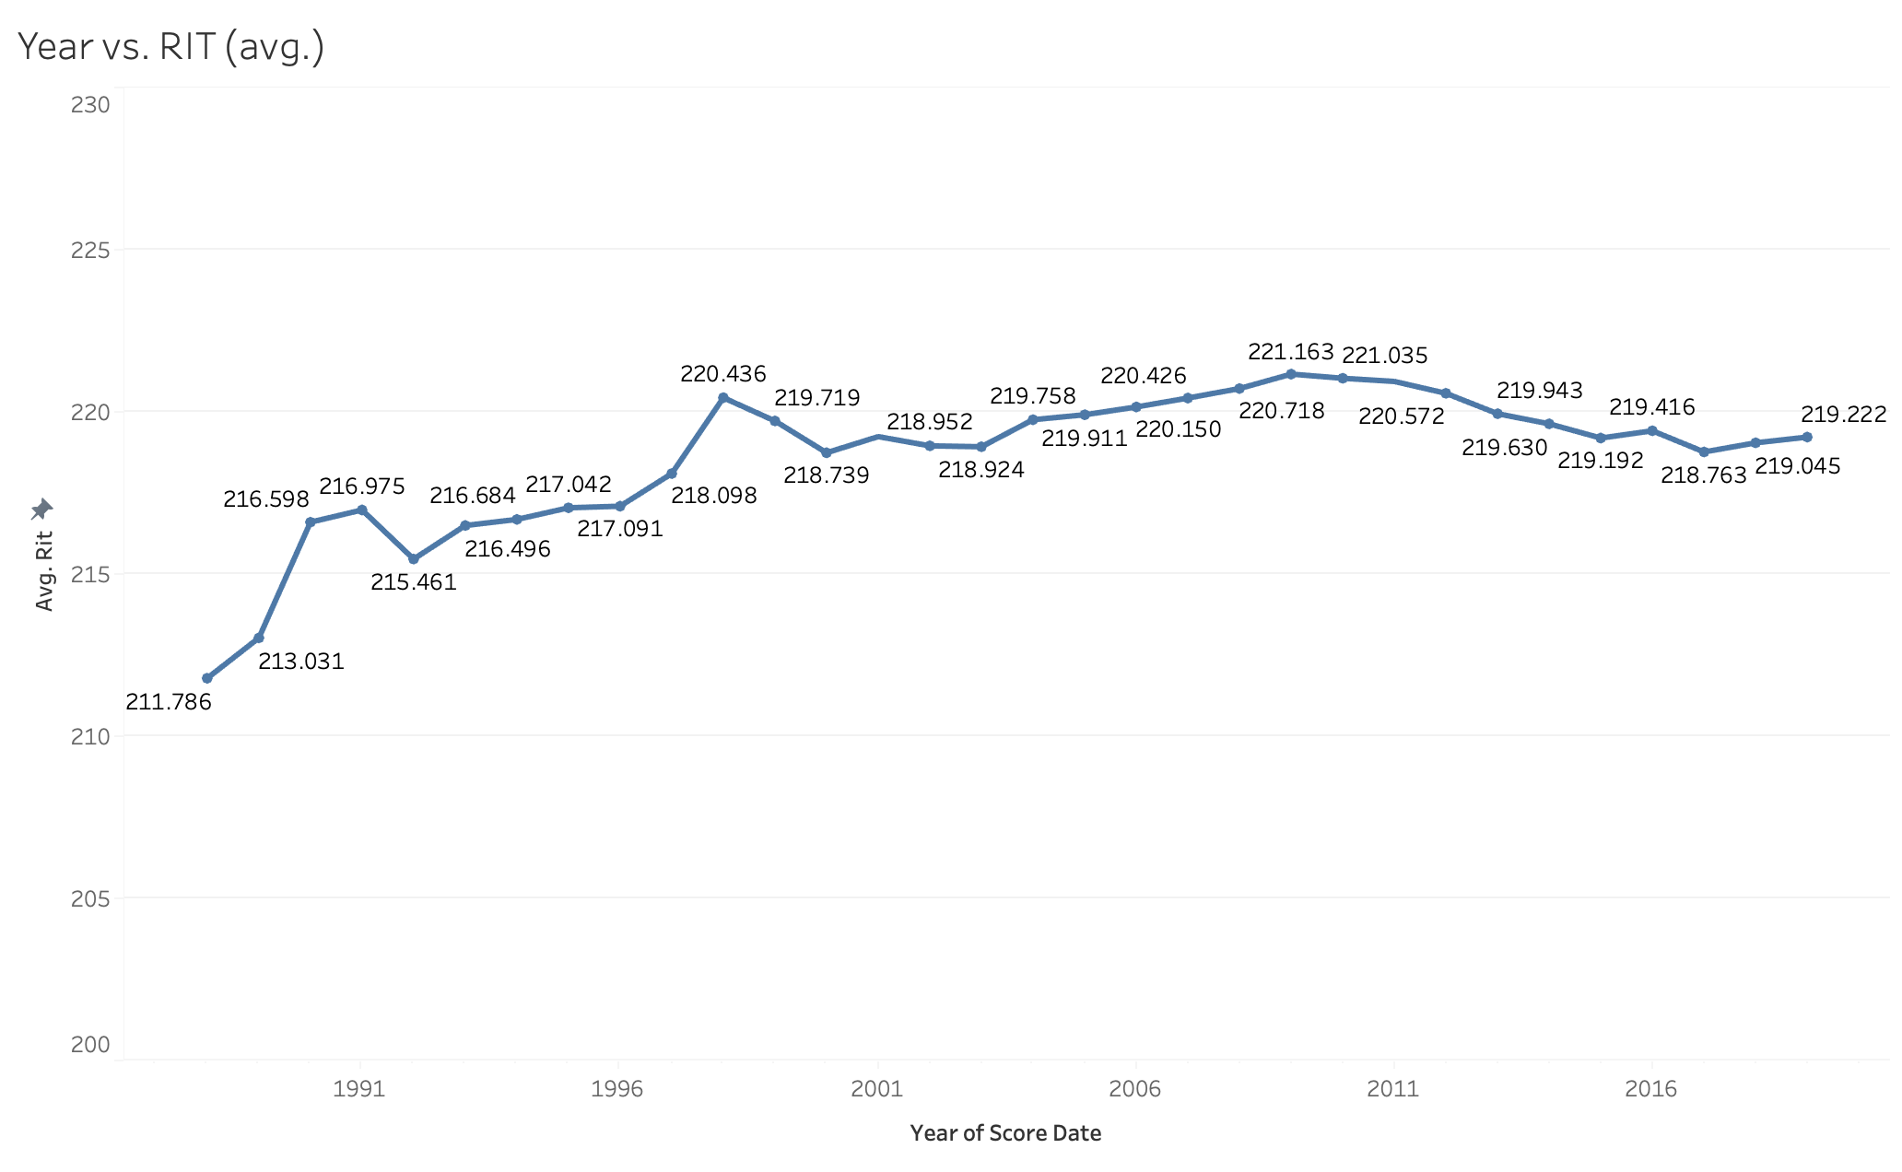
Plot of avg. RIT vs. Years

Slide 10
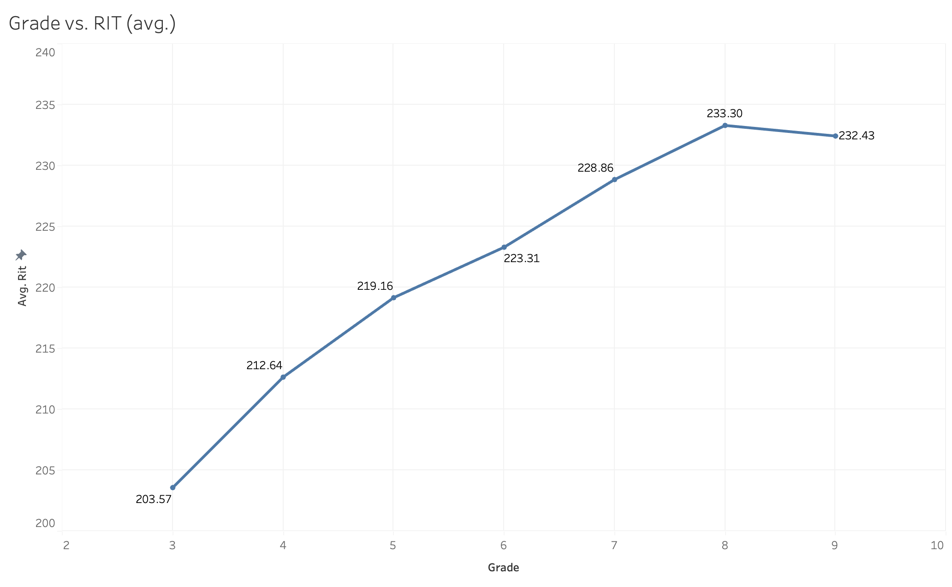
Plot of avg. RIT vs. Grades

Slide 11
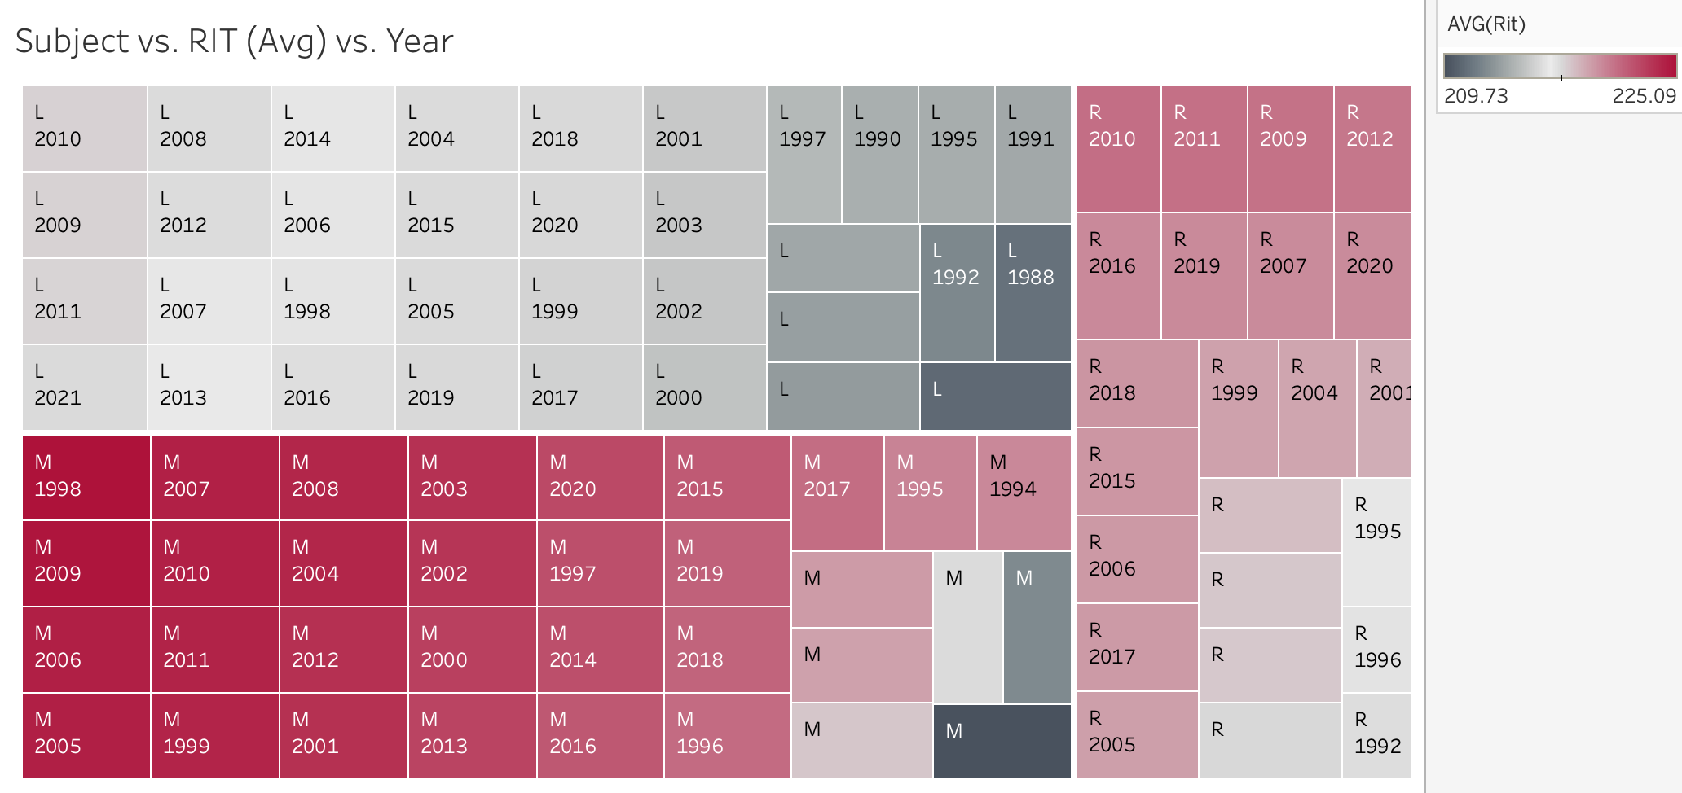
Notes:
Monty

Slide 12
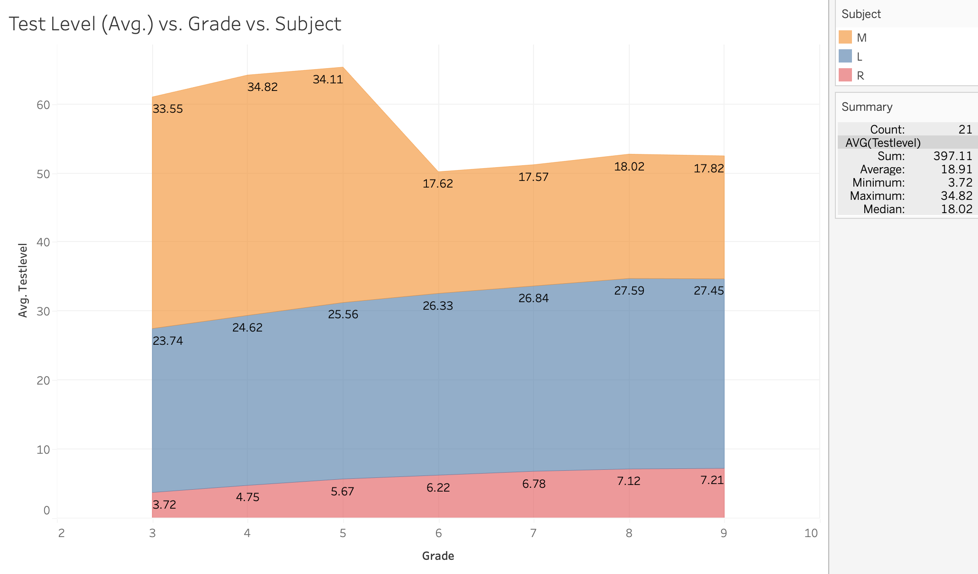
Notes:
Monty

Slide 13
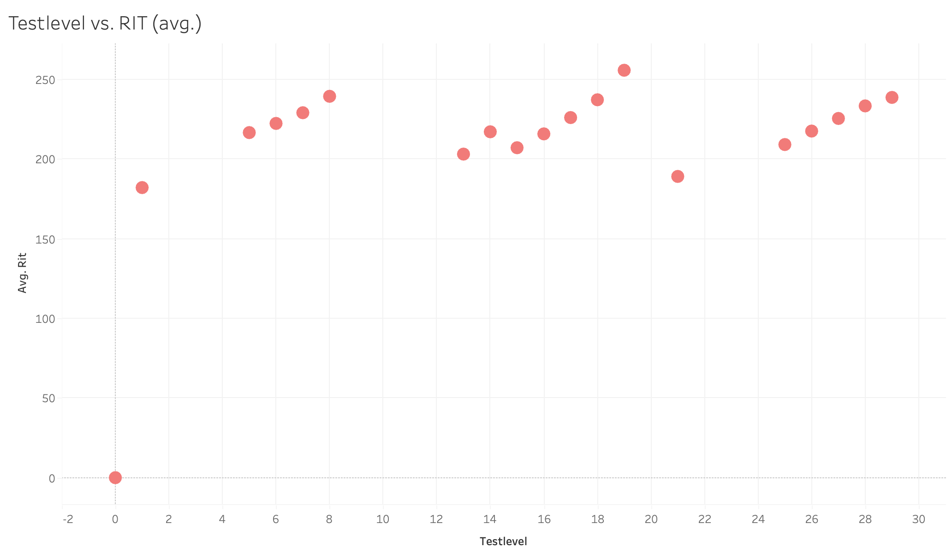
Notes:
NIrjal

Slide 14
Observations on Avg. RIT plots
Avg. RIT is generally increasing across years, grades, and test levels.

Slide 15
Test Level Box Plots
We have created box plots of different grades on each subjects
0 scores cut out
Outliers not shown

Slide 16
Language Arts
Generally Small increase

Slide 17
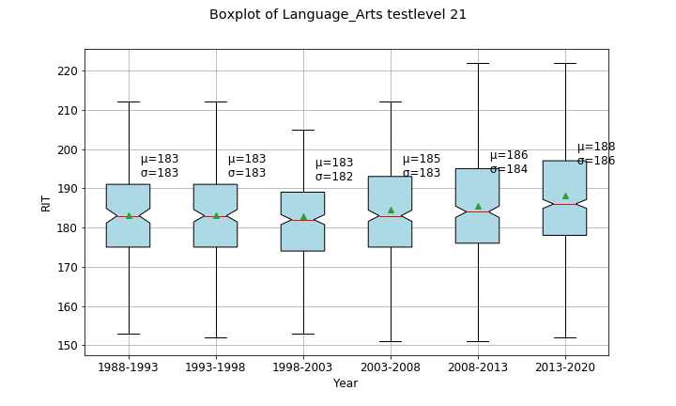
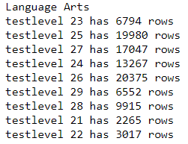
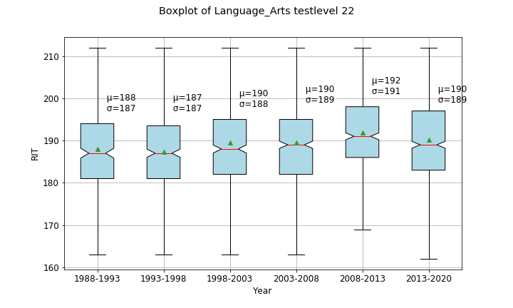
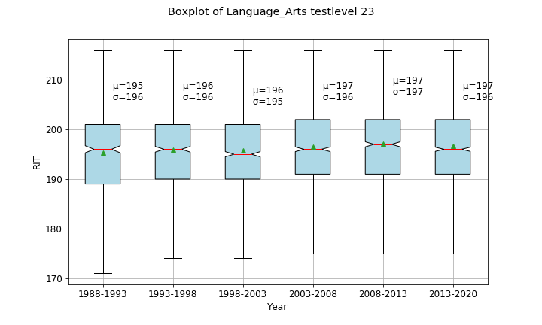
Language Arts
General Increase

Slide 18
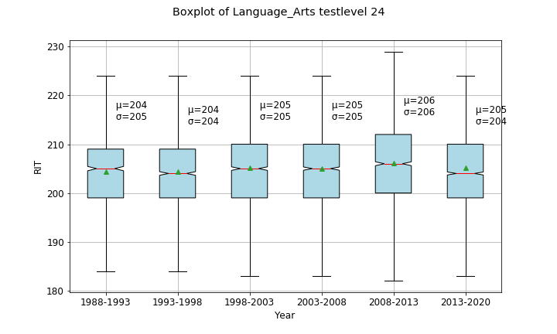
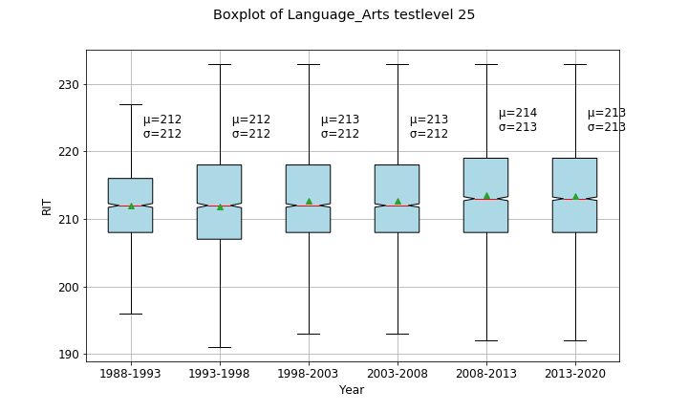
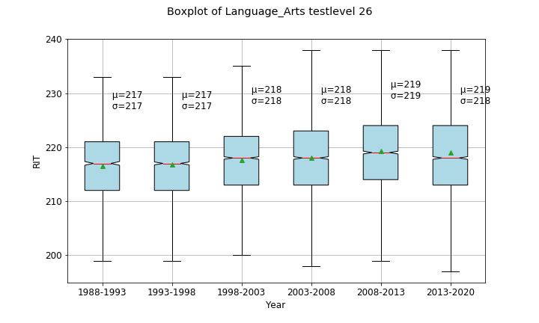
Language Arts
General Increase

Slide 19
Readings
Fluctuating increase

Slide 20
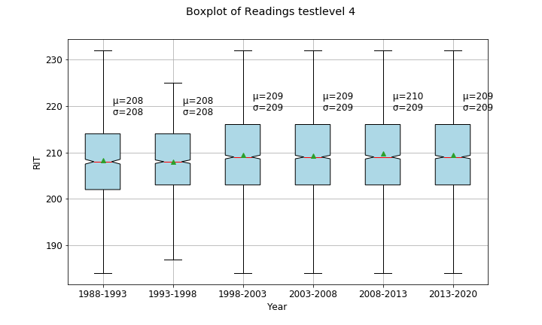
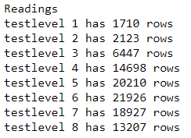
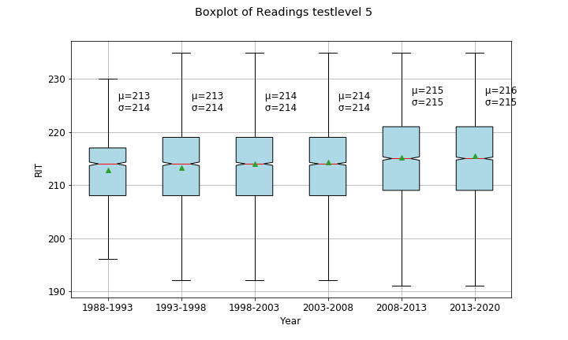
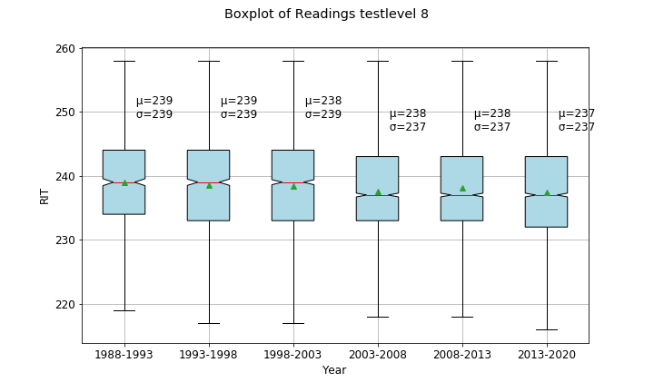
Readings
General Increase

Slide 21
Math (TL > 30)
Big increase
Quadratic
Note: This group of test are for Younger kids

Slide 22
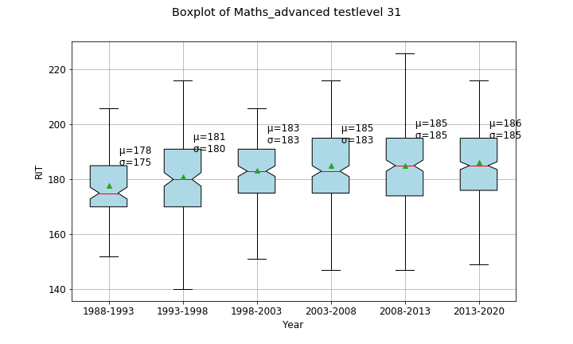
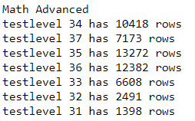
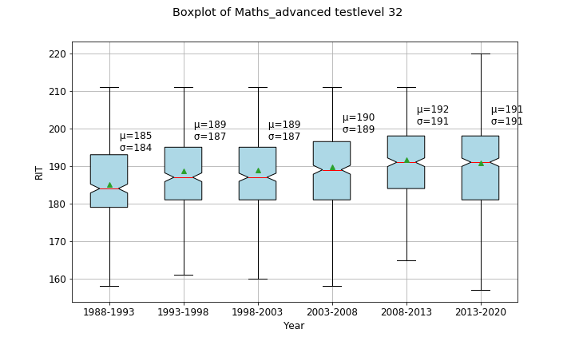
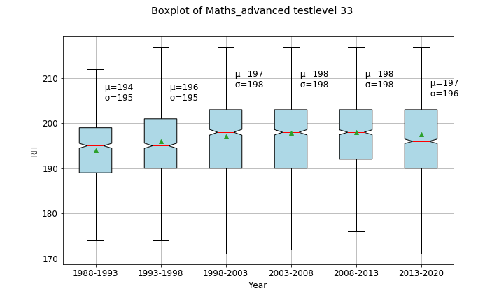
Math (TL>30)
General Increase

Slide 23
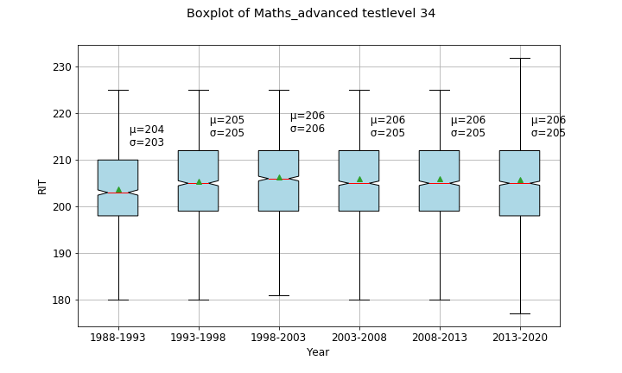
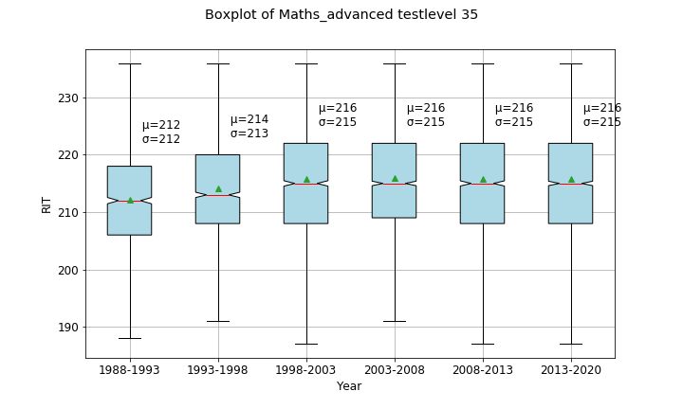
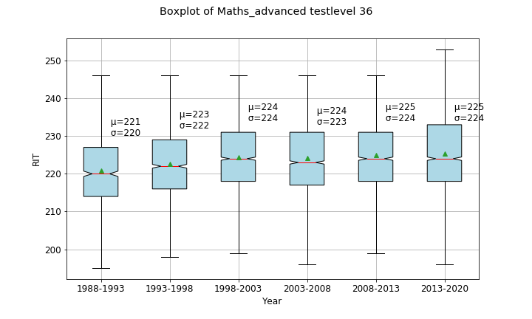
Math (TL>30)
General Increase

Slide 24
Math (T<30)
Quadratic increase
Advances Mathematics for older children

Slide 25
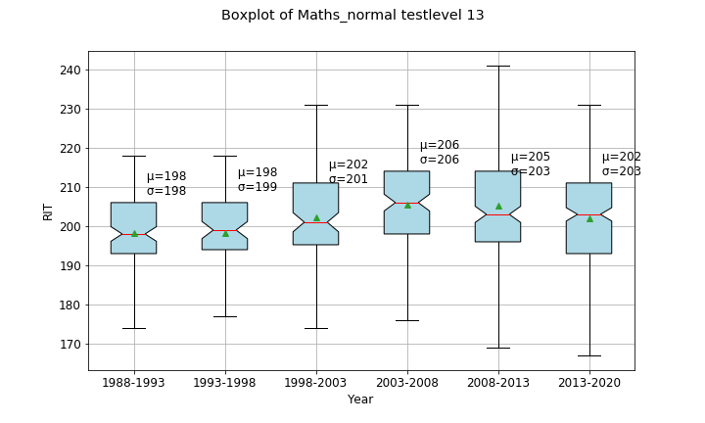
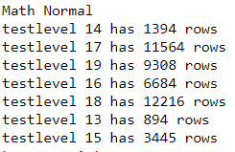
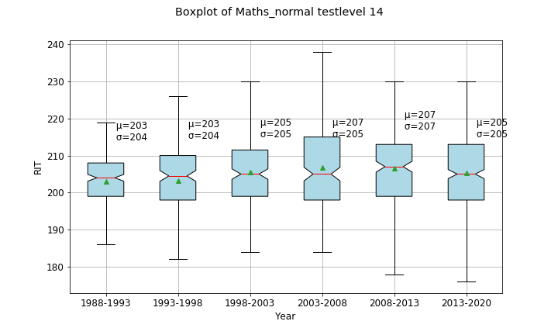
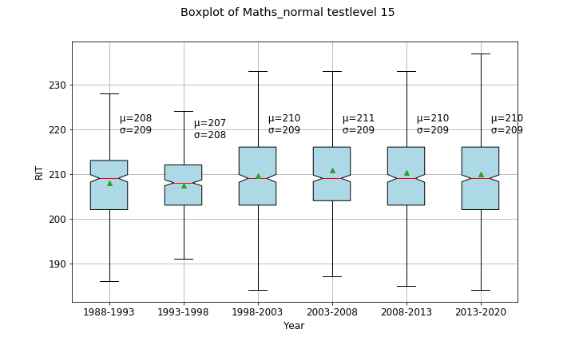
Math (T<30)
General Increase

Slide 26
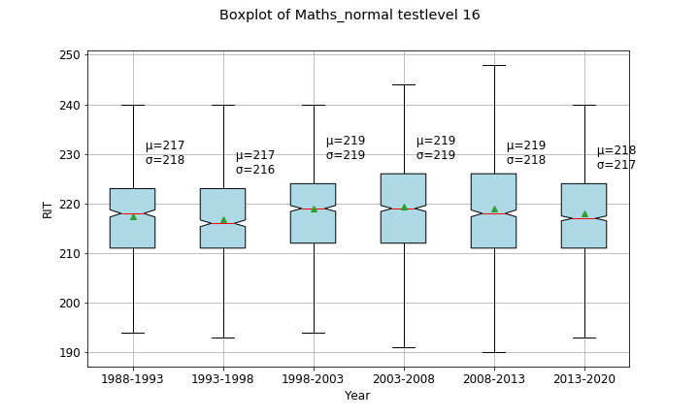
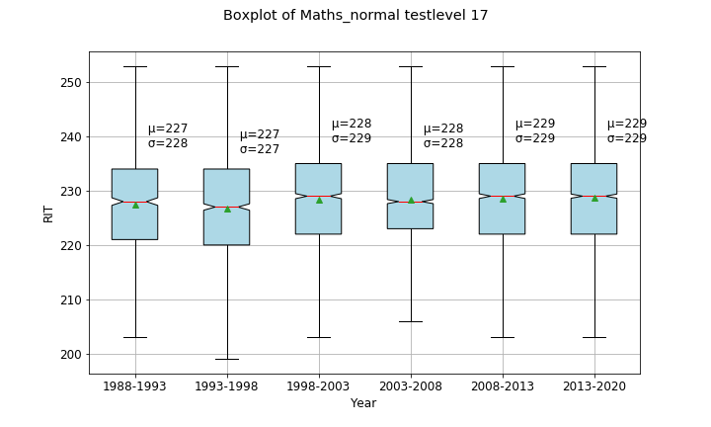
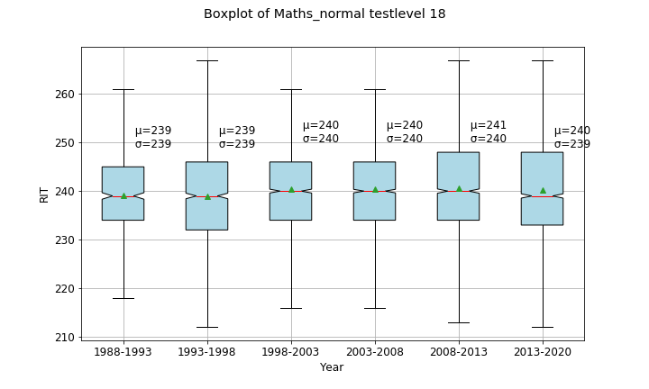
Math (T<30)
General Increase

Slide 27
Mini conclusion
Conclusion
Mean Overall increases slightly for different subjects
Reading fluctuates on specific test levels

Slide 28
Grade Boxplots
We have created box plots of different grades on each subjects
0 scores cut out
Outliers not shown

Slide 29
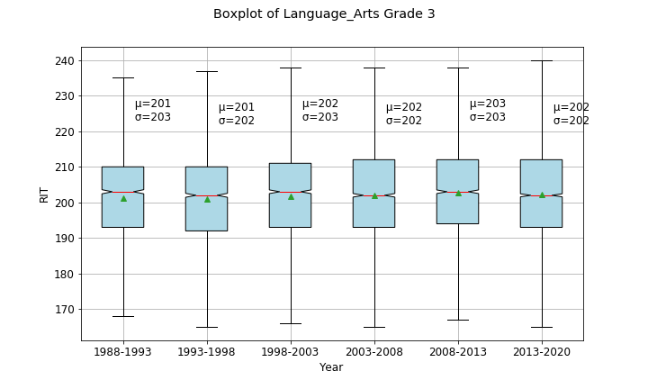
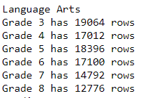
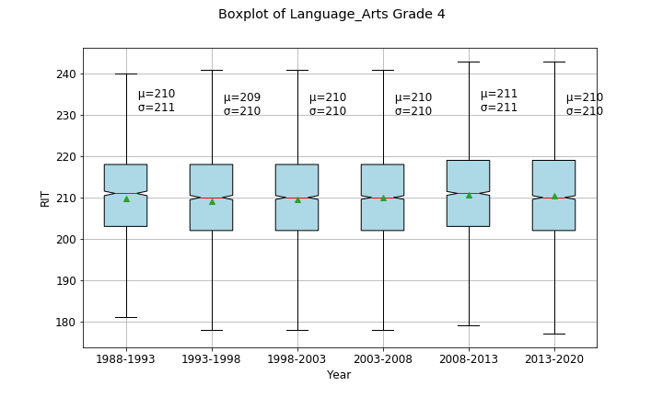
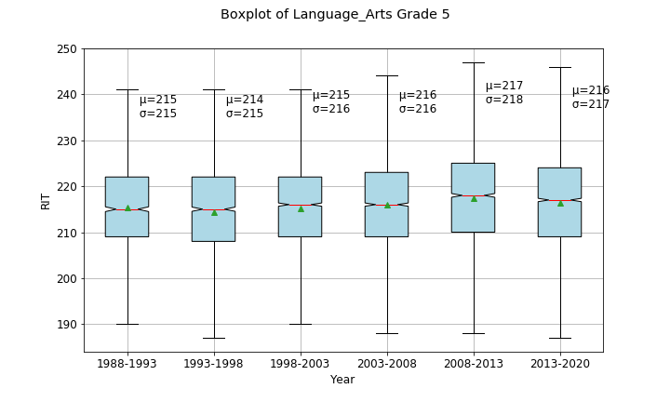
Language Arts (G 3-5)
General Increase

Slide 30
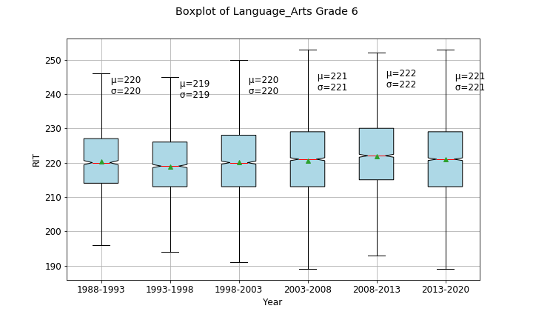
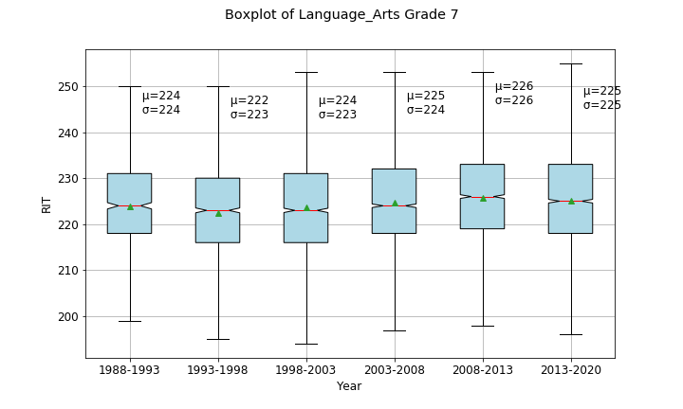
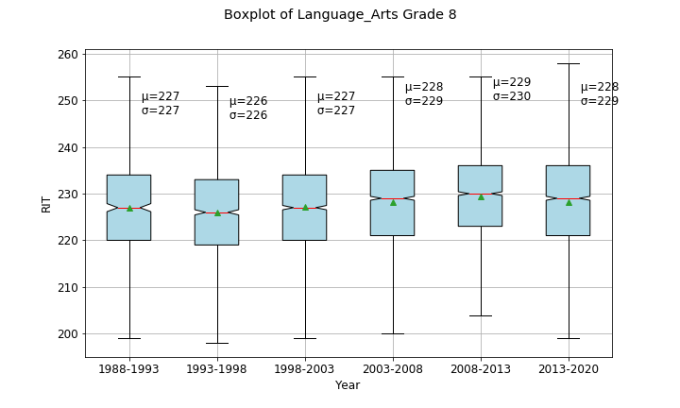
Language Arts (G 6-8)
General Increase

Slide 31
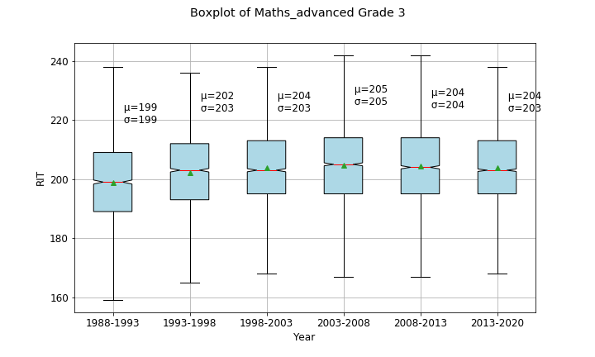
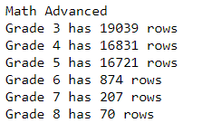
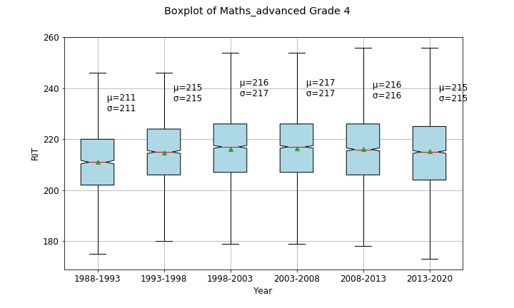
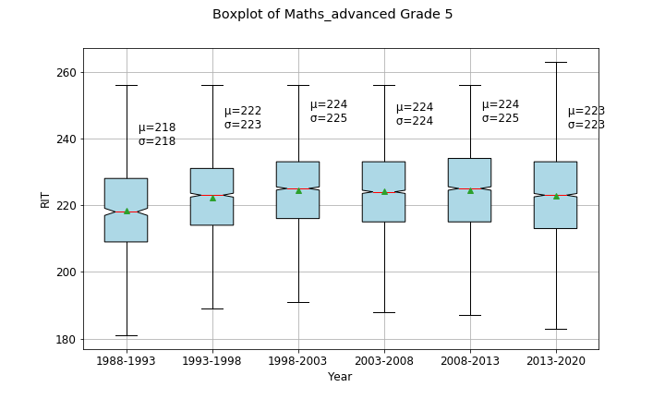
Maths (G 3-5) (TL>30)
Curved Increase

Slide 32
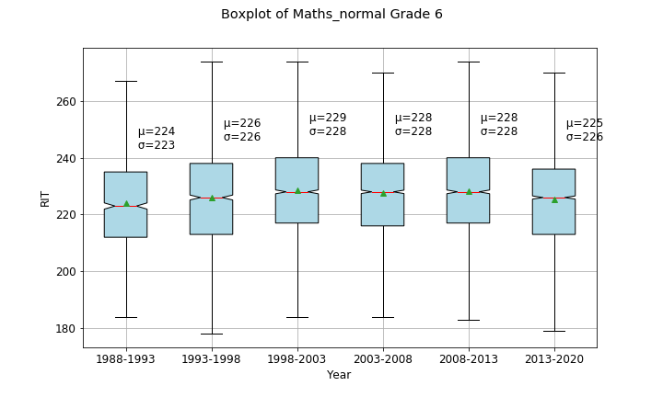
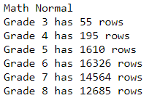
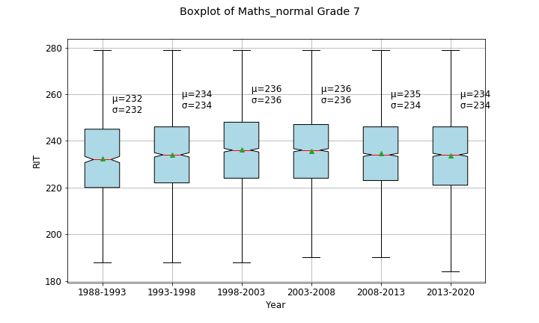
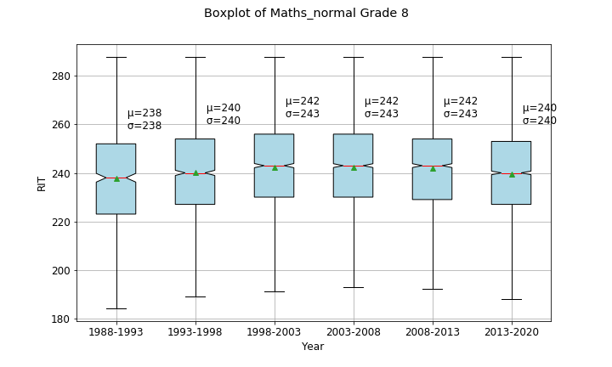
Maths (G 6-8) (TL<30)
Curved Increase

Slide 33
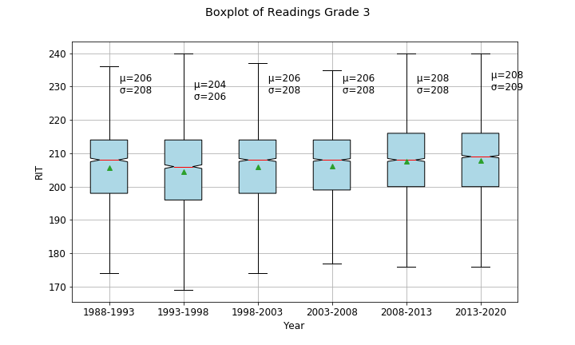
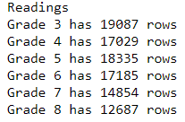
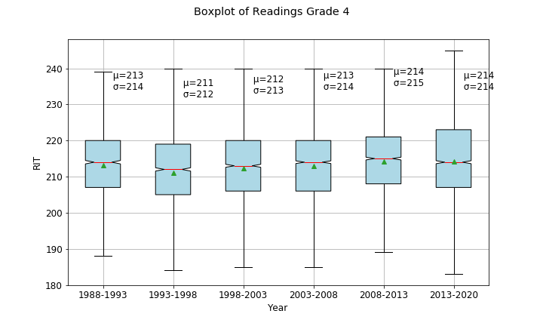
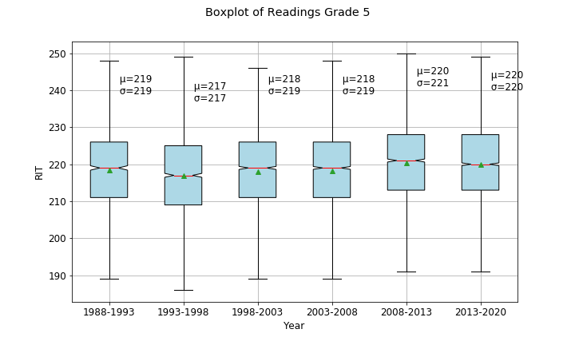
Readings (G 3-5)
Curved Increase

Slide 34
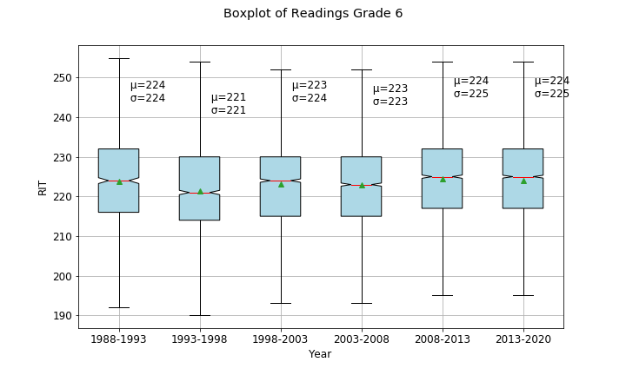


Readings (G 6-8)
Curved Increase

Slide 35
Conclusion
Math Grade goes up in a curved fashion
Language Arts score goes up consistently
Reading scores go up consistently

Slide 36
Bar Charts for Count Vs Year
Notes:
- switching gears
- Taking a different direction.

Slide 37




Overall
Count Vs Year
Notes:
Bar Charts for Count Vs TakenDate - explain attributes (x-axis) - Count (Number of students taking the test) and (y-axis) - TakenDate (Year). - the limits for the axes (x-axis) - 0/1000 and y-axis (years). - the number of people taking the tests have increased significantly from the first five years to the last five for all the subjects. - the only anomaly that we observed in the recent 5 years is 2020. The number of people taking the test has decreased, and it might be due to Covid.

Slide 38




Overall
Count Vs Year
Notes:
The number of people taking the tests have increased across all grade levels in the past 5 years in comparison to the first 5 years. However, the only anomaly or disparity with the data is the one for 2020 as it has significantly reduced numbers due to COVID.

Slide 39
Scatterplot for Count Vs TestLevel

Slide 40




MATH
Count Vs TestLevel
Notes:
Scatter Plot for Count Vs TestLevel - Explain the attributes (axes) - the limits as well - intention behind this analysis: to see which grades were taking the test levels more that impacted the RIT score. - talk about which Test was the most popular for first 5 years vs the most recent 5 years. - for most grades the data is consistent, the test levels for the particular grades remain the same. - but there are some changes in the most popular test between the years. Here are some that stood out among them.

Slide 41




Language & Arts
Count Vs
Count Vs TestLevel

Slide 42




Reading
Count Vs TestLevel

Slide 43
Distribution
mean RIT score has increased
Lacking significant change in distribution
Although students are doing better, the standard deviation is consistent

Slide 44
Linear Model Prediction
Split by subject
Trained on years 1988-1998
Tested on years 2009-2019

Slide 45


Math by Grade
Early | Late

Slide 46


Math by Test Level Test 1
Early​ | Late​

Slide 47


Math by Test Level Test 2
Early​ | Late​

Slide 48


Reading by Grade
Early​ | Late​

Slide 49


Reading by Test Level
Early​ | Late​

Slide 50


Language by Grade
Early​ | Late​

Slide 51


Language by Test Level
Early​ | Late​

Slide 52
Mini Conclusion
Slopes of RIT vs. grade and RIT vs. test level remain similar
But RIT may have gone up overall

Slide 53
Distribution of Lang Scores (Early vs Late)
Conclusion: Distribution is relatively constant

Slide 54
Distribution of Lang Scores (Early vs Late)
Conclusion: Distribution is relatively constant

Slide 55
Distribution of Read Scores (Early vs Late)
Conclusion: Distribution is relatively constant

Slide 56
Distribution of Read Scores (Early vs Late)
Conclusion: Distribution is relatively constant

Slide 57
Distribution of Math Scores (Early vs Late)
Conclusion: Distribution is relatively constant

Slide 58
Distribution of Math Scores (Early vs Late)
Conclusion: Distribution is relatively constant

Slide 59
Standard Deviation of RIT scores
Reading
Math
Language
Conclusion: Distribution is relatively constant

Slide 60
Standard Deviation of RIT Scores
Reading
Math
Language
Conclusion: Distribution is relatively constant

Slide 61






Error in Standard Deviation across Grades and Subjects
3rd
4th
5th
6th
7th
8th
Notes:
Shows how far each standard deviation is from the Mean standard deviation from the plots above

Slide 62

Modeling

Slide 63
Choice of Linear Model
To identify the strength of our independent variable
Our data works well only with the linear regression modelling
Other models are harder to understand with our data.
Notes:
Monty

Slide 64

PCA Chart
Notes:
Kamontat

Slide 65
Modeling Mean RIT Score
Predicting mean RIT score from year + grade
RIT score generalizes to average performance
Normalized
33 data points – no test/train
Less to predict and more to show trends (purpose of research)

Slide 66

Mean Math RIT Score Prediction Model - Logarithmic
better for the younger grades
Demonstrates how math mean RIT score is plateauing
Notes:
Looking at math scores – these aren’t linear

Slide 67
Adjusted R^2 Values for Each Grade
3rd - .73
4th - .58
5th - .75
6th - .32
7th - .19
8th - .23

Slide 68
Adjusted R^2 Values for Each Grade
3rd - .73
4th - .58
5th - .75
6th - .32
7th - .19
8th - .23

Slide 69

Mean Math RIT Score Prediction Model - Quadratic
Better overall
Average r^2 per grade: .66 vs .47
Math scores are decreasing – returning back to original levels
Notes:
Looking at math scores – these aren’t logarithmic either, especially for higher grades

Slide 70
Adjusted R^2 Values for Each Grade
3rd - .75
4th - .72
5th - .84
6th - .60
7th - .36
8th - .68

Slide 71
Adjusted R^2 Values for Each Grade
3rd - .75
4th - .72
5th - .84
6th - .60
7th - .36
8th - .68

Slide 72

Mean RIT Language Prediction Model - Linear
The model does not predict the Mean RIT scores well (quadratic and logarithmic were worse)
Mean language scores have increased over the years
Students are doing better on the language test
Possible Reason: Their learning is more geared towards the material on the test?

Slide 73
Mean Language RIT Score Prediction Model - Linear
3rd - .41
4th - .20
5th - .38
6th - .34
7th - .44
8th - .38

Slide 74
Mean Language RIT Score Prediction Model - Linear
3rd - .41
4th - .20
5th - .38
6th - .34
7th - .44
8th - .38

Slide 75

Mean RIT Reading Prediction Model - Linear
Observation: Scores in early years are all over the place
Possible Reason: a standardized reading test was something very new to students, it has taken a while for them to get use to the test
The model does not predict the Mean RIT scores well (quadratic and logarithmic were worse)
Important: mean reading scores have increased over the years

Slide 76
Mean Reading RIT Score Prediction Model - Linear
3rd - .61
4th - .42
5th - .34
6th - .10
7th - .15
8th - .13

Slide 77
Mean Reading RIT Score Prediction Model - Linear
3rd - .61
4th - .42
5th - .34
6th - .10
7th - .15
8th - .13

Slide 78
Linear Model for predicting mean RIT scores

Slide 79


Grouping the Data
Data Grouped by Year, RIT (mean), Grade (mean), Test Levels (mean)
Summary of the Linear Model

Slide 80


Model Plots (with Regression Line):

Slide 81
Analysis of Linear Model (by Residual Values)*
Criteria for Analysis:
The mean of residuals is 0.
The distribution of residuals is normal.
All the residuals are uncorrelated.
Variance of residuals is Homoscedastic (constant).
* A residual is a vertical distance between Data Point (actual value) and Regression Line. Thus, residuals are equal to values in the data.

Slide 82



Test Normality of the residual distribution
Jarque – Bera Normality Test (To compare p-values with other models)
Null Hypothesis for JB test: data is perfectly normalized (or normally distributed)
Histogram
Normal Q-Q plot

Slide 83

Observation on Normality:
P-value is small (0.087) but much larger than in comparison with all other models that we've created before.
Reject Null Hypothesis as Data is not perfectly normalized but still is somewhat normalized as shown in the histogram.
Q-Q plot shows only one point off the normal line but others are relatively close to the normal line.
It's clear from the histogram and Q-Q plot that residuals are normally distributed.

Slide 84

Test Variance of the residual distribution
Studentized Residuals
Observation:
Plot shows that there aren’t any obvious outliers. Based on the plot it's okay to assume the constant variance assumption.

Slide 85

Test Correlation between Residuals
Durbin – Watson independency Test (To compare p-values with other models)
Null Hypothesis for DW test: residuals of time series data are completely uncorrelated
Observation:
P-value is small (0.0001) but still much larger than in comparison with all other models that we've created before.
Reject or Fail to reject Null Hypothesis ? there's some correlation but least correlation.
We can conclude that the Variables we've used in this model has least correlation than any other combination of variables.

Slide 86

Test Mean of all Residuals
Plot of Residuals by RIT (mean)
Observation:
half of the residuals are above 0 and half below (shows that mean of all residuals is 0)
Also, calculation by mean(df$residuals) gives 0.000....

Slide 87
Conclusions of Linear Regression Model
Both Multiple and Adjusted coefficient of determination (R-square) values of 0.90 and 0.89 respectively shows that predicted values are closely fitted to regression line.
The observations resulting from each criteria satisfies the error assumptions.
This model have passed some of the most important criteria of Residual analysis.
It's okay to say that this is pretty solid linear model and it's giving correct predictions.

Slide 88

Future Research
Explore trends of performance on different types of questions within each subject test
Train a model that predicts standard deviation for different test levels, subjects and grades
Notes:
Kamontat

Slide 89
Overview of Findings
Students who took test in more recent years have done better (RIT scores increasing)
Student performance is correlated with year
Lang and reading RIT scores per grade are increasing more linearly over the years
Math RIT scores follow a quadratic trend
RIT scores are proportional to grades
Distribution of RIT + standard deviation scores isn’t changing significantly
% increase in the number of students taking the test by years?
% increase in the Mean_RIT scores by years?
Notes:
Gen – top half
Nirjal – bottom half

Slide 90

Overall
% Increase in Count
Notes:
Percent_Change (Mean_RIT) - explain the attributes (axes) - limits as well - intention behind it: we saw that the Mean RIT scores increased over the years, but we wanted to see what percent it was changing by. - from this analysis, we saw that every subject is increasing between the range of ___ to ___ % of the initial Mean_RIT score.

Slide 91

Overall
% Increase in Mean_RIT
Notes:
Percent_Change (Count) - explain the attributes (axes) - limits as well - intention behind it: we saw that the number of people taking the tests were increasing, so we wanted to see by how much?

Slide 92
Conclusion
Re normalization and redesign of the test are not necessary
Distribution of test scores is consistent
Students are doing better
Different types of students are taking (different motives for home schooling)
Students and parents know better how to prepare for the test
Students are more accustom to the test
Students are more accustom to standardized testing in general
Notes:
Ben – top half
Rachna – second half

Slide 93
Resources Used
Larose, Chantal D., and Daniel T. Larose. Data Science Using Python and R. Wiley Blackwell, 2019.
R, Python, Tableau
Websites:
“Extract and Replace Substrings from a Character Vector - str_sub.” - str_sub • Stringr, stringr.tidyverse.org/reference/str_sub.html.
Guest, et al. “R Is Not So Hard! A Tutorial, Part 4: Fitting a Quadratic Model.” The Analysis Factor, 6 July 2018, www.theanalysisfactor.com/r-tutorial-4/.
“Get Maximum Value of a Column in R.” DataScience Made Simple, 24 Dec. 2020, www.datasciencemadesimple.com/get-maximum-value-of-a-column-in-r-2/#:~:text=Maximum%20value%20of%20a%20column%20in%20R%20can%20be%20calculated,maximum%20value%20of%20that%20column.
“How to Plot Multiple Data Series in Ggplot for Quality Graphs?” Sixhatnet, www.sixhat.net/how-to-plot-multpile-data-series-with-ggplot.html.
Huynh, Y. Wendy. “R For Graduate Students.” 11.5 Graphing with Different Datasets, 6 Aug. 2019, bookdown.org/yih_huynh/Guide-to-R-Book/graphing-with-different-datasets.html.
IantheIanthe 4, et al. “Mean per Group in a Data.frame.” Stack Overflow, 1 Nov. 1962, stackoverflow.com/questions/21982987/mean-per-group-in-a-data-frame.
JeffJeff 5, et al. “How to Obtain RMSE out of Lm Result?” Stack Overflow, 1 Dec. 1965, stackoverflow.com/questions/43123462/how-to-obtain-rmse-out-of-lm-result.
“Learn by Marketing.” Learn by Marketing | Data Mining + Marketing in Plain English, www.learnbymarketing.com/tutorials/linear-regression-in-r/.
Shekhar, Prashant. “How to Apply Linear Regression in R.” DataScience+, 16 Jan. 2018, datascienceplus.com/how-to-apply-linear-regression-in-r/.
Stephanie. “Jarque-Bera Test.” Statistics How To, 16 Apr. 2021, www.statisticshowto.com/jarque-bera-test/.
Twain, Mark. “About Us.” Hewitt Learning, hewittlearning.org/about-us/.
“Visualising Residuals • BlogR.” BlogR on Svbtle, drsimonj.svbtle.com/visualising-residuals.
“x.” Durbin-Watson Test with Residual Inputs - MATLAB, www.mathworks.com/help/stats/dwtest.html#:~:text=The%20p%2Dvalue%20of%20the,and%20indicates%20autocorrelation%20among%20residuals.

Slide 94
Questions?

Slide 95
Bonus Slides

Slide 96



Language Arts

Slide 97



Readings

Slide 98

A decrease in score

Slide 99



Maths (G 3-5) (TL<30)

Slide 100

Another Increase

Slide 101



Maths (G 6-8) (TL>30)

Slide 102

Notes:
Rachna

Slide 103


Slide 104


Slide 105



Slide 106


